Slide 1
Brain Health

Slide 2
About the brain
Hello Brain provides easy-to-understand scientific information about brain health.
http://www.hellobrain.eu/en/
brainhealth/topic?id=brain-basics

Slide 3
12 risk factors associated with dementia
That if addressed, could reduce dementia by up to 40 per cent:
Lower levels of education in early life
Social contact in later life
Excessive alcohol consumption
Traumatic brain injury
Air pollution
Hypertension
Hearing impairment
Smoking
Obesity
Depression
Diabetes
Physical inactivity
Source: https://www.google.com/search?q=lancet+commission+2020+dementia+risk+reduction&rlz=1C1GCEU_enIE821IE821&oq=lancet+commission+2020+dementia+risk+reduction&aqs=chrome..69i57.7352j0j7&sourceid=chrome&ie=UTF-8

Slide 4
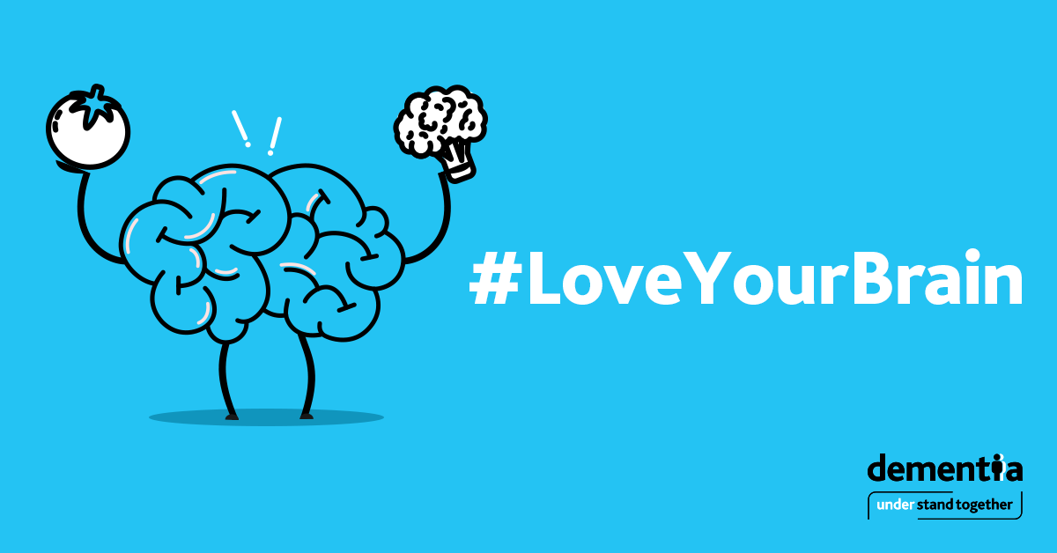
Some of the risk factors overlap with known risks for heart disease and stroke, like hypertension and diabetes.
Some also increase the risk of cancer, such as smoking.
Thus, reducing these risks has wide health benefits.
Some risks are more specific to dementia, like hearing loss
and brain trauma, but still very worthwhile as part of an
overall approach to reducing individual risk.

Slide 5
Under pressure: Healthy adults above 40 years of age should have their blood pressure (BP) checked annually to see if it is within the healthy range. There are many ways to decrease blood pressure such as exercising, losing weight, reducing salt intake, limiting alcohol, and taking medication if prescribed.
Listen up: Reduce hearing loss by protecting ears from excessive noise exposure. If experiencing hearing problems, you should get your hearing tested. It’s also important to wear a hearing aid if prescribed one.
Breathe carefully: Reduce exposure to air pollution and to second-hand tobacco smoke.
Use your head: Prevent head injury, including concussion, which can occur in certain sports, or due to falls. In addition to national policies for safe sports, each individual can take precautions such as always wearing the correct protective headwear for sports, cycling, work, etc.

Slide 6
5. Drink in moderation: If you drink alcohol, stay within the low-risk weekly guidelines, i.e. less than 17 standard drinks for men or 11 standard drinks for women. For more information on low-risk drinking guidelines, visit www.askaboutalcohol.ie, or call the HSE Alcohol Helpline on 1800 459 459.
6. Up in smoke: Quitting smoking may reduce your risk of developing dementia as well as your risk of developing cancers and heart disease. Stop smoking for 28 days and you’re five times more likely to stop for good. For more information, visit www.quit.ie or call the QUITline on 1800 201 203
7. Adopt a healthy weight: Achieving or maintaining a healthy weight during your lifetime, but particularly in mid-life, is also important – being more active and following a healthy diet can help this.
8. Be a good sport: Physical activity is very important for brain health. Sustained exercise in mid-life, and possibly in later life, protects from dementia. Every adult should aim to include 150 minutes of physical activity, such as brisk walking, in their week.

Slide 7
Eat well: Eating a wide variety of nourishing foods provides the energy and nutrients you need to keep your brain healthy. A balanced diet that is rich in vegetables, fruit, wholegrains, and fish, and that is low in salt and sugar, is a good starting point.
Mind your mind: Depression might be a risk for dementia, although dementia itself can also cause depression. Visit www.yourmentalhealth.ie for ways to look after your mental health.
Early to bed: Addressing other possible risk factors, like sleep, through lifestyle interventions, will improve general health and may reduce your risk.
Brain box: Keep your brain active. Do a crossword or puzzle. Remember your shopping list instead of writing it down. Be curious and take an interest in people. Learn something new or take up a hobby.

Slide 8
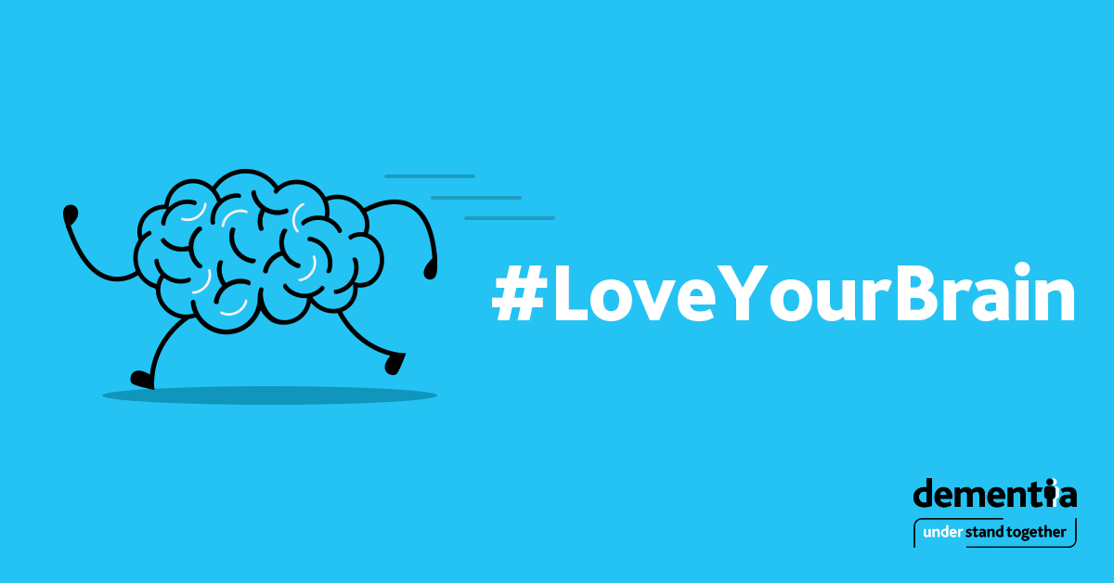
Key take home messages:
Dementia risk factor modification needs to start in
middle-aged people, not in older age.
2) We may not always be able to prevent dementia, but
delaying the age of onset in Ireland by 5 years would
halve the prevalence of dementia.

Slide 9
Get Involved Email: fiona.foley@alzheimer.ie www.understandtogether.ie
Notes:
Thank you

