Slide 1
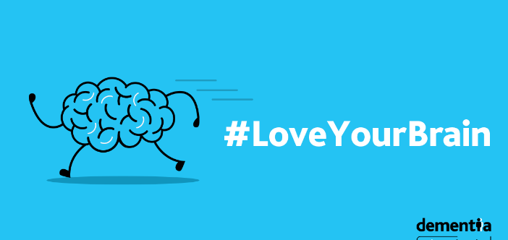
Think Brain Health

Slide 2
It is your thoughts and feelings and memories
Your brain is who you are
It is curious and creative and it needs to be protected
Notes:
We often take our brains for granted and don’t take the time to think about how wonderful it is, and why it is so important to look after our brain.

Slide 3




What is Brain Health
Memory
Learning
Play
Concentration
Brain health is about making the most of your brain and helping reduce some risks to it as you age.
Notes:
You might have heard about brain health before, so what does the WHO say?
Brain health is defined by WHO as “the state of brain functioning across cognitive, sensory, social-emotional, behavioural and motor domains, allowing a person to realise their full potential over the life course, irrespective of the presence or absence of disorders.
Brain health must be the key to health, as defined by WHO, because the brain is the agent of all our actions and the mediator of all our experiences.

Slide 4
The World Health Organisation defines
Brain Health as the promotion of optimal brain development, cognitive health and well-being for all across the life course

Slide 5

Did you know that…
A lifetime of curiosity and learning new skills can help you to function longer and better
The brain has the ability to change and adapt
Activity, attitude and simple lifestyle changes can boost your brain health
Cognitive decline is not an inevitable part of ageing
Notes:
We need to look after our brain health because there's no health without brain health, it's core to your wellbeing and quality of life, there are things you can do to protect your brain, you can build reserve in your brain that protects you from 'wear and tear' effects of aging and potentially decrease your risk of dementia.

Slide 6
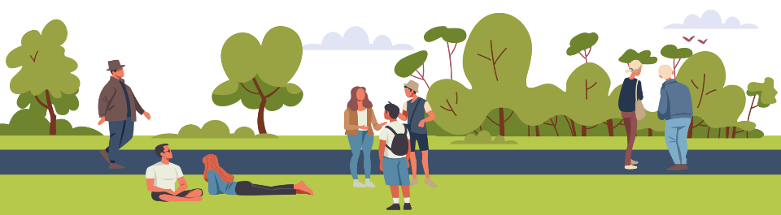
We understand a great deal more about what impacts our brain health than we did even ten years ago.
For most people, the conditions that lead to dementia start in midlife and the onset of these is driven by many factors.
Some of which we can’t change, such as family history and genetics, but many of which we can, such as our lifestyle.
Notes:
What we now know.

Slide 7




Evidence supports that
There are 14 potentially modifiable risk factors for dementia which if addressed could reduce dementia by up to 45%
If we delay the onset of dementia by 5 years can halve its prevalence.
https://www.thelancet.com/infographics-do/dementia-risk
Notes:
If you were told you could reduce your risk of cancer by 45%, would you do it?

Slide 8
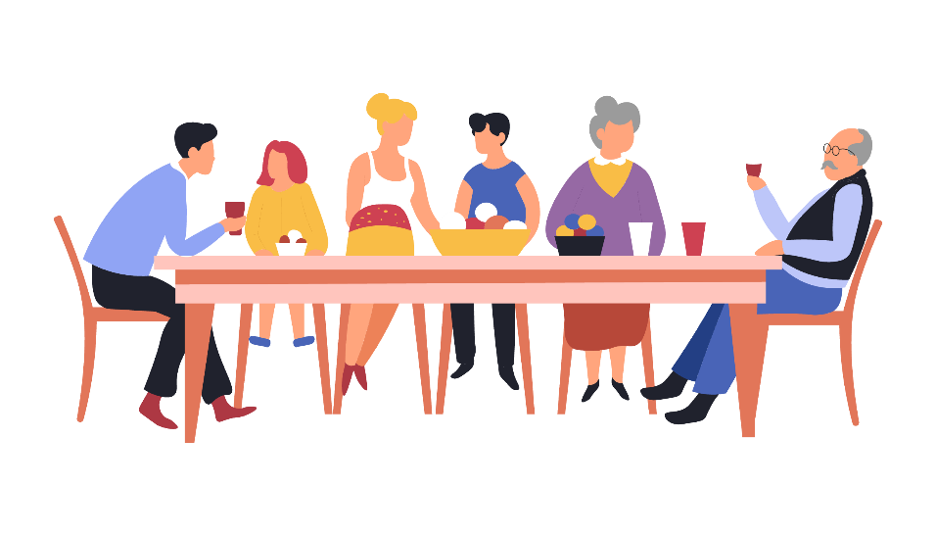
Over 64,000
people are currently living with dementia in Ireland
Notes:
The prevalence figures were provided by Health Atlas based on the 2020 census. These are estimated figures and there may be many more people who have a diagnosis of dementia or are living with the condition.
Why is that important?
Keeping our brain well is important for everyone. Even if you have a diagnosis of dementia looking after your brain health, may slow down the progression of dementia, and can also support your overall health and wellbeing.

Slide 9
The number of people with the condition will more than
double
in the next 25 years
Notes:
So it is never too early or too late to look after our brain health.

Slide 10
There are 14 modifiable risk factors
Minimise diabetes
Treat hypertension
Prevent head injury
Stop smoking
Reduce air pollution
Reduce midlife obesity
Treat high LDL cholesterol
Reduced neuropathological damage (amyloid or tau-mediated, vascular or inflammatory)
Maintain frequent exercise
Reduce occurrence of depression
Avoid excessive alcohol
Reducing the risk of dementia
Increased and maintained cognitive reserve
Treat hearing impairment
Treat vision loss
Maintain frequent social contact
Attain high level of education
Notes:
Looking at the 14 risk factors we can see that they have an impact on neuropathological damage and also on our cognitive reserve.

Slide 11
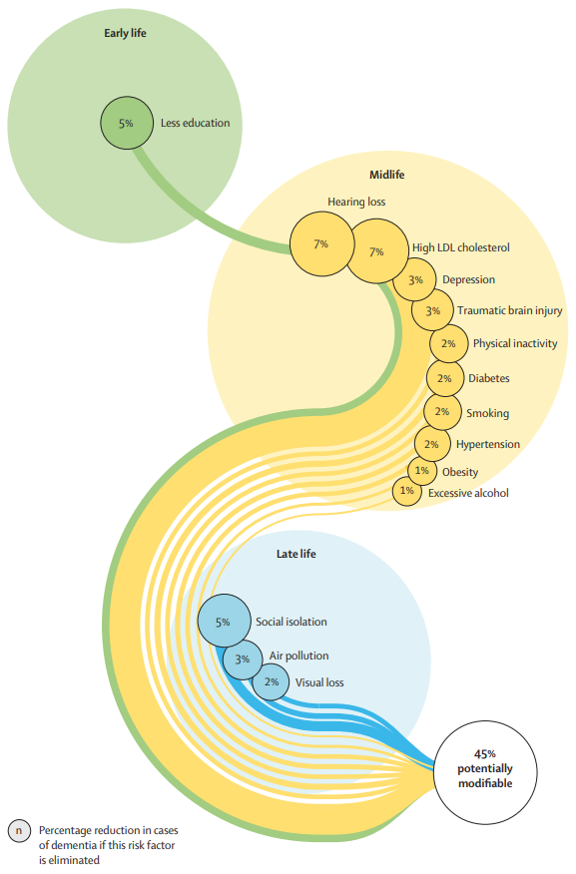
Dementia risk factors across the lifecycle
Lifestyle has a profound impact on our brain health
Very similar to advice given for stroke, heart disease and cancer
Infographic: Dementia prevention, intervention and care: 2024 Report of the Lancet Commission, Prof Gill Livingston.
Notes:
Some of the risk factors are especially profound at various stages in our lives.
This converted S shape shows risk factors in early, middle and late life and if we look at the health advice for many of them it is similar to advice given for stroke, heart disease and cancer.

Slide 12
Good overall health may help to maintain brain health
Healthy Eating
Regular Exercise
Keeping your Brain Active
Social
Connect
ions
Getting enough sleep

Slide 13



We can shape our messages around these themes
Stay sharp
Love your heart
Keep connected
Notes:
We can shape our public health messages around these main themes.

Slide 14








Diet and Nutrition
A balanced diet is a good starting point to look after our body and mind.
Nuts, seeds, beans, whole grains, plant based foods
Lean meats and fish
Fruits
Vegetables
Olive oil
A wide variety of nourishing foods provides the energy and nutrients you need to keep your brain healthy.
Notes:
Looking at love your heart aspects such as diet, physical activity, smoking all play a role in this. So what can we do?

Slide 15

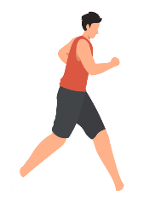
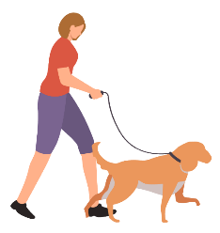
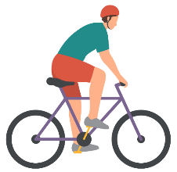
Physical activity
Being physically active can boost your brain.
Every adult should aim to include 150 minutes of physical activity, such as brisk walking, in their week.
Notes:
Examples of activities: running, walking, yoga, cycling, hiking, swimming, chair exercise, household chores.
Equal emphasis on including muscle strengthening activity 2 days a week. And moving more (light intensity) every day to reduce amount of time spent sedentary.
The brain has over one billion neurons.
Heart beats roughly 120, 000 times.
25% of the blood flow goes to the brain.
What is good for our hearts is also good for our brains.

Slide 16
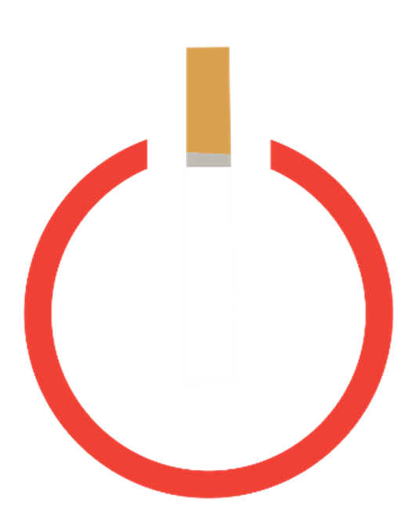
High LDL Cholesterol
Ensure you get your cholesterol checked regularly
If your LDL cholesterol is too high, get it treated
Your GP can tell you about the most suitable type of treatment, including medication
Changing your diet, stopping smoking and exercising more can also help prevent or manage high cholesterol
Notes:
New evidence shows high cholesterol as a potential risk factor.
The 2024 Lancet report states that overall, high-quality, consistent, biologically plausible
evidence exists that high LDL cholesterol in midlife is a risk factor for dementia.

Slide 17
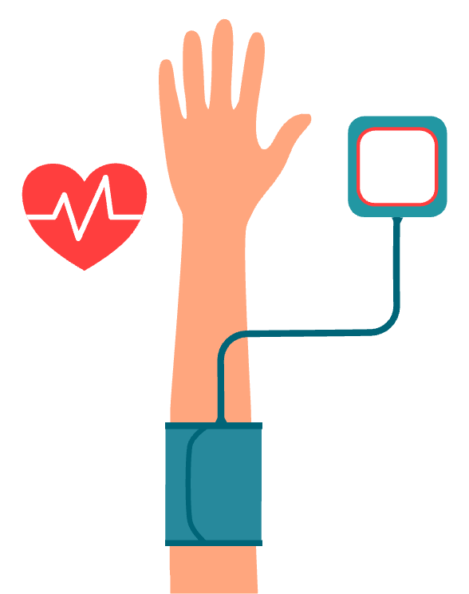
Blood pressure
Exercising and eating healthily, reducing stress, limiting alcohol, and taking medication if prescribed, can help to keep your blood pressure low.
Notes:
This also links in with our blood pressure. Healthy adults above 40 years of age should have their blood pressure (BP) checked annually to see if it is within the healthy range.

Slide 18


Alcohol
Consuming alcohol can affect the way your brain functions.
Drink in moderation:
Drinks should be spread out over the week.
Have 2 to 3 alcohol-free days per week.
Stay within the guidelines
11 standard drinks for women
17 standards drinks for men
Example of a standard drink
a small glass of wine (12.5% volume)
a half pint of normal beer
an alcopop (275ml bottle)

Slide 19
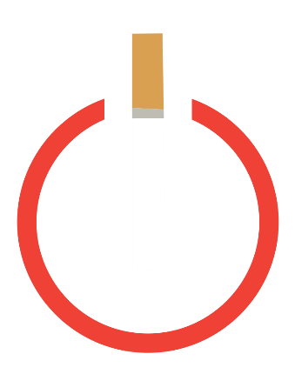
Smoking
Quitting smoking may reduce your risk of developing dementia as well as your risk of developing cancers and heart disease.
Did you know that if you stop smoking for 28 days and you’re five times more likely to stop for good?

Slide 20


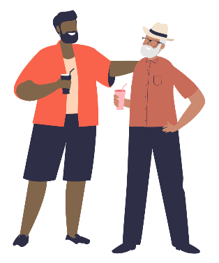
Keep connected
Social isolation is increasingly thought to be a risk factor for dementia
It also increases the risk of hypertension, heart conditions and depression
Let’s get outside even for 10 or 20 minutes to get the mood boosting effects of fresh air and natural scenery
You can also try a new hobby, stay in touch with family and friends, or reach out to services within your community
Notes:
Depression might be a risk for dementia, although dementia itself can also cause depression.

Slide 21
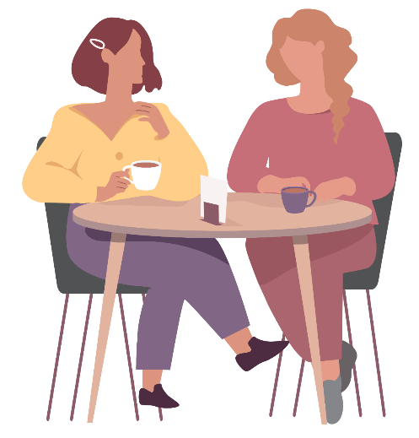
Keep connected
Interacting with others can give us great sustenance in terms of brain health.
Join a book club
Community group
Men’s or Women’s shed
Choir or a sports team
Have a regular coffee morning
The local library also has lists of activities.
Notes:
Sometimes it is hard to get started, but there are many local activities such as night classes, book clubs, games clubs, active retirement groups, volunteering opportunities, ciorcail comhrá.
You can ask a friend or family about a local group, the library is a great place to go for information.
Other options are the Age Friendly coordinators and social prescribers in your area.

Slide 22
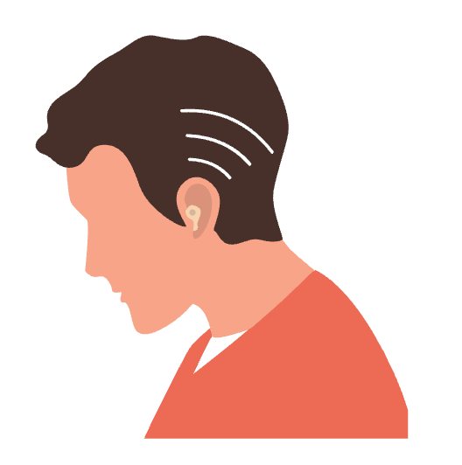
Hearing Loss
Hearing loss is associated with a higher risk of developing dementia.
Let’s protect our ears from excessive noise exposure
Get your hearing tested, if you are having difficulties
Do wear a hearing aid if it is prescribed
Notes:
Lancet Commission report shows that hearing loss is the largest modifiable risk factor against dementia. In fact, moderate hearing impairment can increase one's risk of dementia by 3-fold. This is due to the fact that hearing loss leads to lowered mental stimulation, isolation, and, ultimately, cognitive decline. Fortunately, hearing aids have been shown to protect against cognitive decline by keeping the brain actively engaged in everyday life.

Slide 23
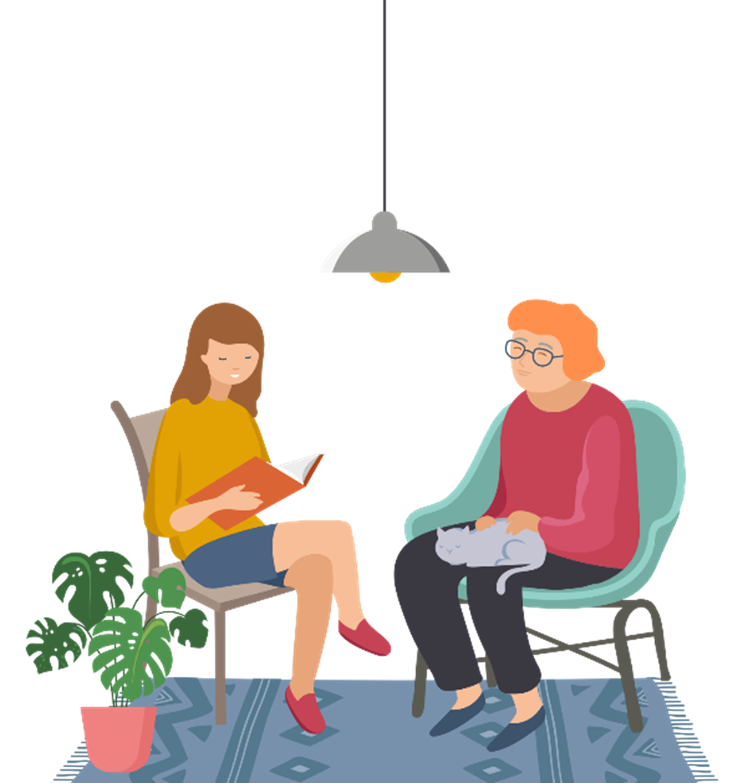
Vision Loss
You can take steps to look after your eye health.
Rest the eyes. Take a break from staring at a screen every 20 minutes
Wear protective eyewear
Wear sunglasses. Choose sunglasses that protect the eyes from 99–100% of both UVA and UVB radiation
Get your vision tested if you are having difficulties
Get treatment for vision loss

Slide 24
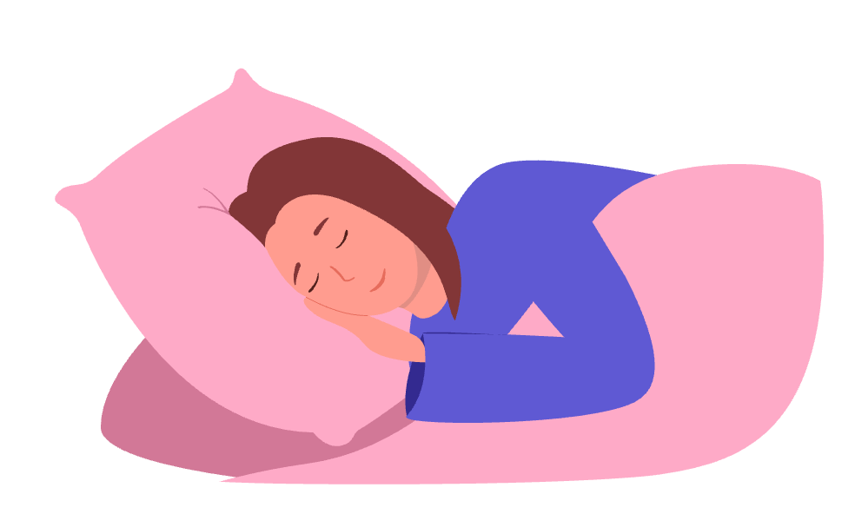
Stay sharp
Keep your brain active
Get a good night’s sleep
Take time for your mental wellbeing
Learn ways to keep stress at bay to benefit your physical health, brain fitness and overall memory
Notes:
Staying sharp is another good way to protect our brain health.
Do a crossword or puzzle
Remember your shopping list instead of writing it down
Be curious and take an interest in people
Learn something new or take up a hobby
Meet family and friends
Slow down before you go to sleep, disconnect from IT, do things that help you relax

Slide 25
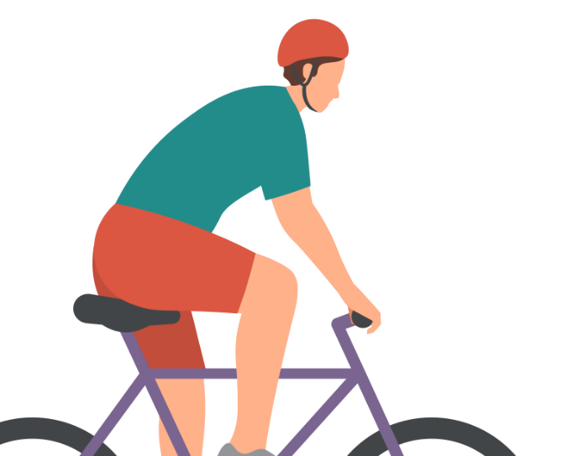
Brain injuries
Prevent head injury, including concussion, which can occur due to falls or traffic accidents.
Take precautions, such as
wear the correct protective headwear for sports, cycling, work, etc.
wear a seatbelt
avoid falls especially for older adults and children
Notes:
There are other risk factors such as brain injuries, education and air pollution, which we will briefly touch.

Slide 26

Education
Cognitive stimulation is important for all of us, but especially in early life.
Higher education levels in childhood and lifelong learning can reduce your dementia risk.
It is never too late to learn something new.
Notes:
We have to be mindful that some people may never have had the opportunity of further education, but have acquired
knowledge through their lifetime.
Also people learn differently, not always academic. This can be explored further.

Slide 27

Air pollution
Breathe carefully
The environment can affect our brain health.
Reduce exposure to air pollution and second-hand tobacco smoke.
Create environments which support brain health.
Notes:
The HSE Climate Action Strategy 2023 -2050 aims to achieve net-zero emissions by 2050 and provide healthcare that is environmentally and socially sustainable.
We can integrate sustainability into our
sustainable buildings and the green environment
transport and mobility
sustainable procurement
greener models of healthcare
water and waste management
adaptation and resilience (increasing resilience of critical infrastructure and resources)

Slide 28
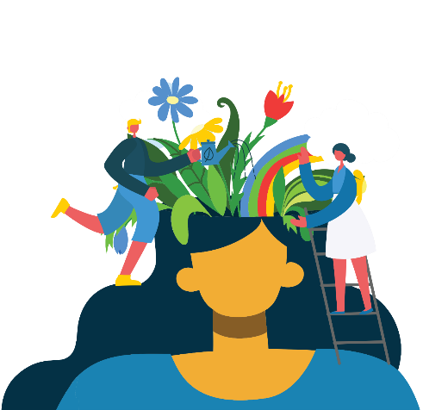
Be inspired and empowered
There is a lot we can do to look after our brain health
regardless of our age or current health status.
Notes:
Looking after our brain health can help reduce our risk of diseases that lead to dementia, but can also support people with dementia post diagnosis.

Slide 29
Key messages
Stimulate your brain by being with people and learning new skills
It is never too early or too late to look after your brain health.
Our lifestyle can affect our brain health and risk of developing dementia.
Eat, exercise and sleep well to help keep your brain healthy
Manage stress to stay as calm as possible

Slide 30
Resources
Hello Brain provides easy-to-understand scientific information about brain health. www.hellobrain.eu/en
The Global Brain Health Institute brings together a powerful mix of disciplines, professions, backgrounds, skills, perspectives, and approaches to develop new science-based solutions for brain health. www.gbhi.org/about
Ask about Alcohol - visit www.askaboutalcohol.ie or call the HSE Alcohol Helpline on 1800 459 459.
Quit - visit www.quit.ie or call the QUITline on 1800 201 203
Eating Well guidelines https://www2.hse.ie/living-well/healthy-eating/
Be active guidelines https://www2.hse.ie/living-well/exercise/active-for-your-lifestyle/
Mental Health - visit www.yourmentalhealth.ie for ways to look after your mental health.

Slide 31
Helpline and information
If you or a loved one are concerned about dementia you can contact the
National Helpline provided by the Alzheimer Society of Ireland at
1800 341 341
You can also find out more about dementia here
https://alzheimer.ie/about-dementia/i-am-worried/

